Slide 1

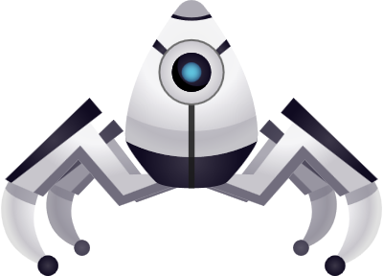
Humanoid
Robot
Presentation by: Muhamed Ramic (1915869)

Slide 2
Table of Content
01
Introduction
What are humanoid robots?
02
History of humanoid robots
How is the background of humanoid robots structured?
Applications
03
How and where are humanoid robots used?
Main components
04
Frame design
Navigation systems
3. Propulsion systems
4. Control systems
5. Daya collection and transmission
6. Power Management
SWOT Analysis
04
Consideration of strength, weaknesses, opportunities and threats.
05
Conclusion
Including famous quote’s

Slide 3
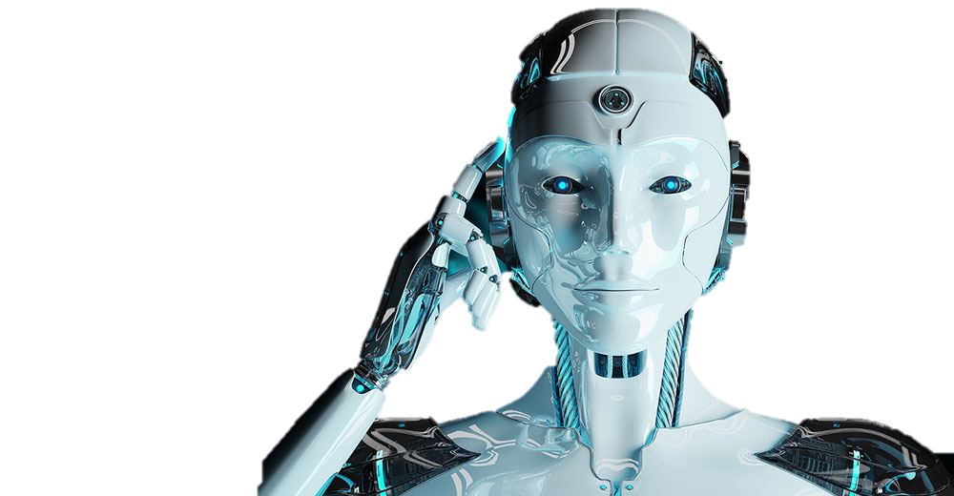

Introduction
Establishment of Humanoid Robots

Slide 4
Introduction
The New Innovations
Humanoid robots are becoming increasingly prevalent in our society, and their potential impact is immense.
These robots are designed to resemble humans in both form and function, and they have the ability to interact with people in ways that traditional robots cannot. With advances in technology, humanoid robots are becoming more sophisticated and capable of performing a wide range of tasks.
Humanoid robots often have a bipedal frame and an erect stance like humans. To observe and engage with their environment, they can be fitted with a range of sensors, actuators, and artificial intelligence technologies.
They can be utilised for development and study to investigate human-like movement, behaviour, and cognition.
“At bottom, robotics is about us. It is the discipline of emulating our lives , of wondering how we work” – Rod Grupen.

Slide 5
What are humanoid robots?
Humanoid robots are robots that are designed to resemble humans in appearance and behavior. They typically have a head, torso, arms, and legs, and they are capable of moving and interacting with their environment in much the same way as humans do. Unlike other types of robots, which are often designed for specific tasks or functions, humanoid robots are intended to be versatile and adaptable.
Examples of humanoid robots include ASIMO, Pepper, and Sophia. These robots are designed to be able to walk, talk, and respond to human interaction. They can be used in a variety of settings, including healthcare, education, and entertainment.
The mechanics and structure of human bodies have been studied by researchers in the field of biomechanics, which has helped them better grasp the concepts behind balance, dexterity, and movement.
The development of AI was essential in enabling robots to observe and comprehend their surroundings.

Slide 6
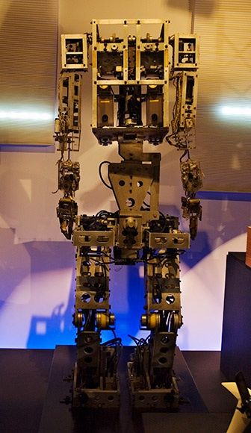
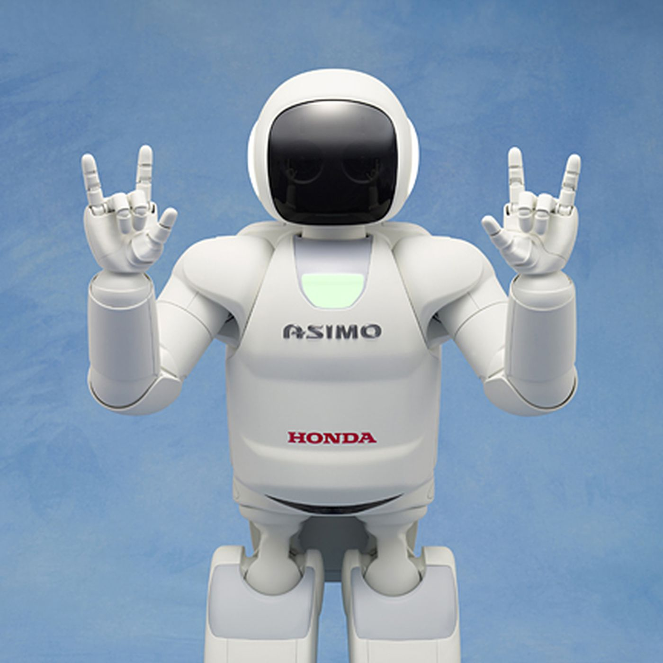
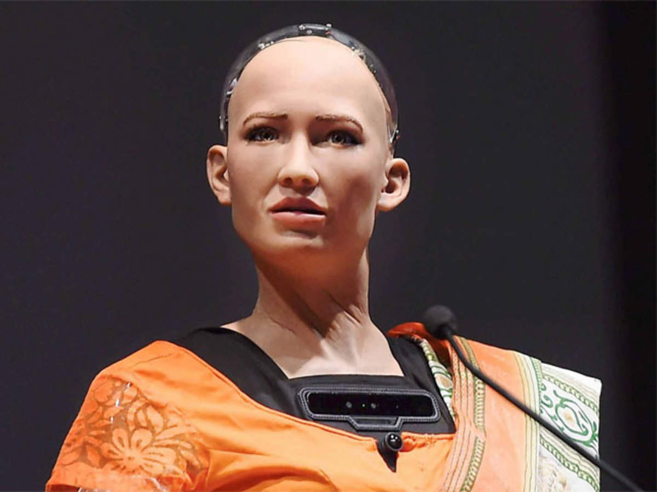
History of humanoid robots
The history of humanoid robots dates back to the early 20th century, when scientists and engineers began experimenting with machines that could mimic human movement. However, it wasn't until the 1970s that the first true humanoid robot was developed. This robot, called WABOT-1, was created by researchers at Waseda University in Japan. Honda's Advanced Step in Innovative Mobility (ASIMO) programme achieved important strides in humanoid robots in 2000. ASIMO was made to run, climb stairs, and engage in conversation with people. It was able to distinguish faces, objects, and gestures. On the other hand, Sophia was developed by Hanson Robotics in the United States and was marketed as a "social robot" that can mimic social behavior and induce feelings of love in humans.
WABOT-1
SOPHIA
A
ASIMO
C
B

Slide 7
Applications
How and where are humanoid robots used?
Today, humanoid robots are used in a variety of applications, including healthcare, manufacturing, and education. They can be used to assist with tasks such as patient care, factory assembly, and teaching. As technology continues to advance, the potential applications for humanoid robots are virtually limitless. They are also used in areas such as entertainment, customer service, healthcare and for social companionship.

Slide 8
MAIN COMPONENTS
1
2
3
Frame &
Design
Navigation
system
Propulsion
system
4
5
6
Control
System
Data
Collection
Power management

Slide 9
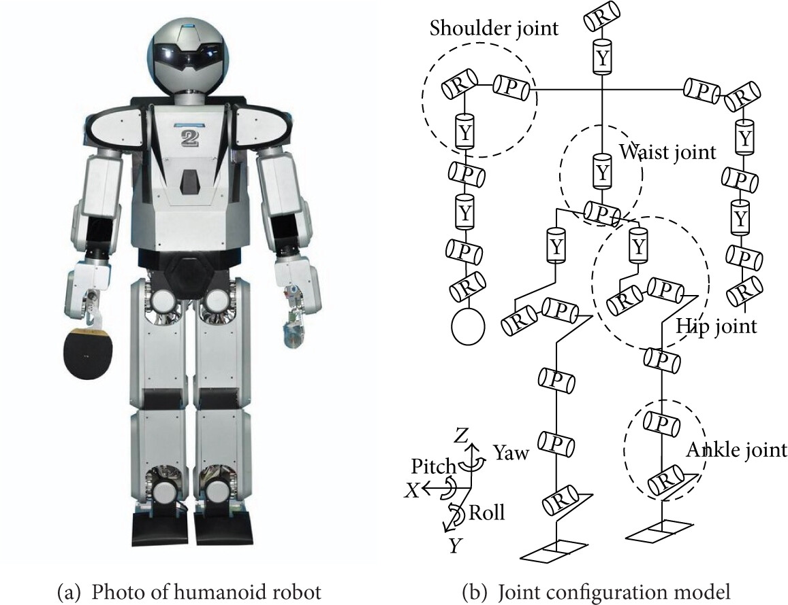
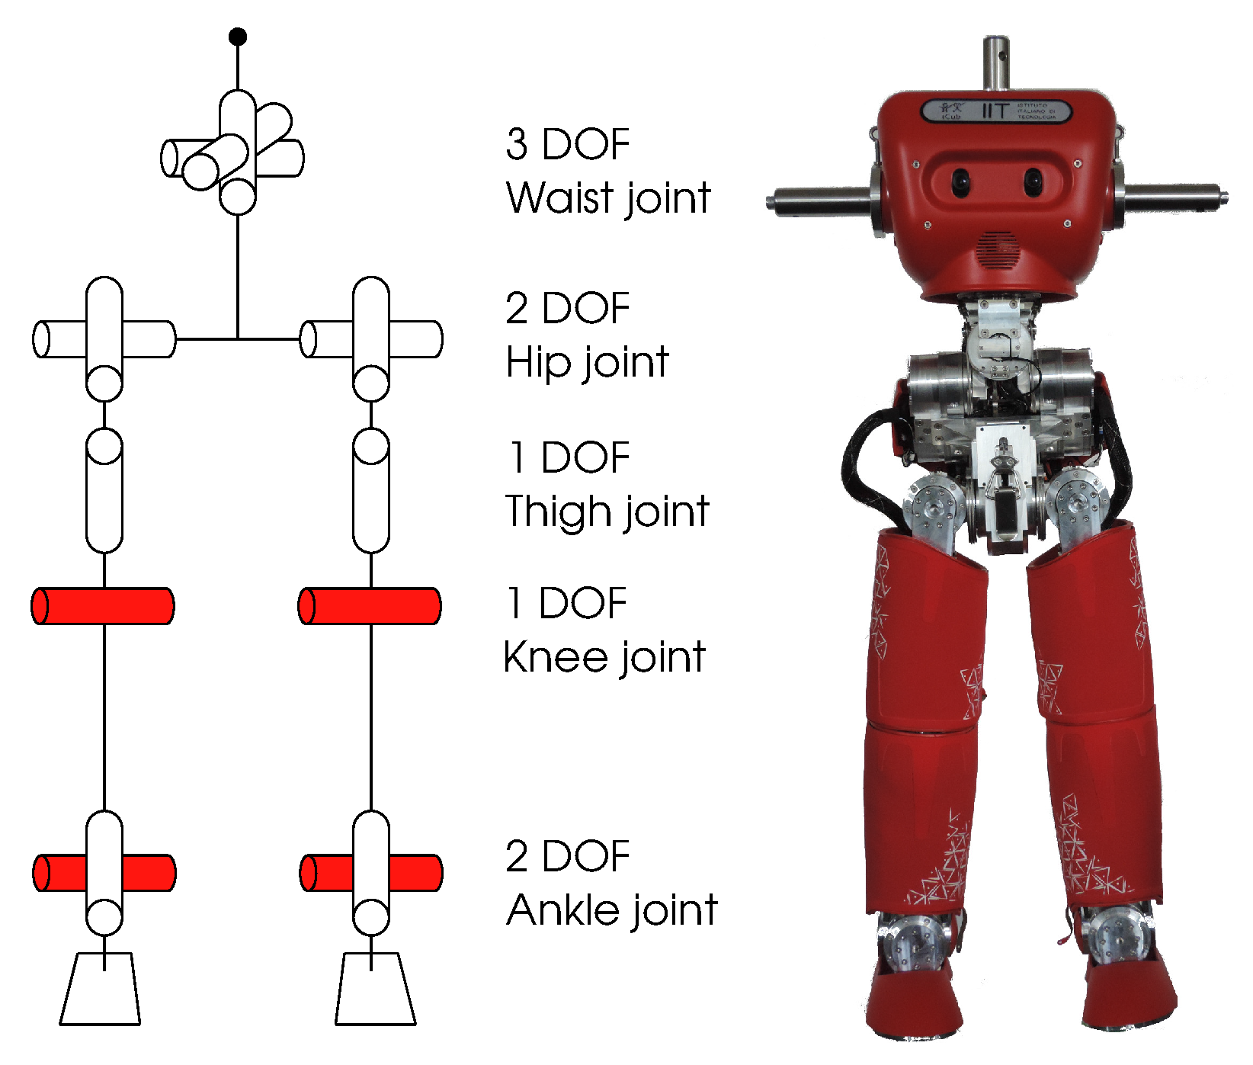
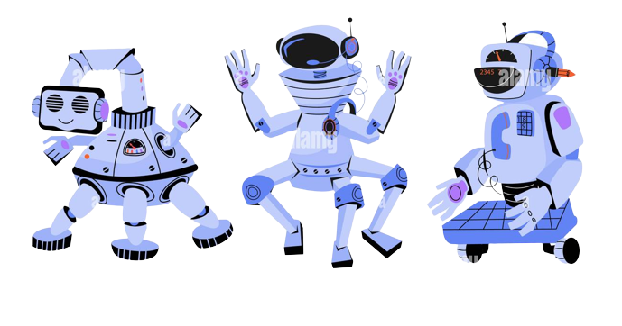
1. Frame & Design
A humanoid robot's structural frame often offers stability and support to the body as a whole. Typically, it is constructed from stiff, light-weight materials like aluminium, carbon fibre composites, or high-strength polymers. The framework is made to withstand loads and forces produced by motion and interaction.
Due to their numerous joints, humanoid robots can imitate a variety of human actions and positions.
For the required force and flexibility, joints are typically operated by motors, hydraulic systems, or pneumatic systems.

Slide 10
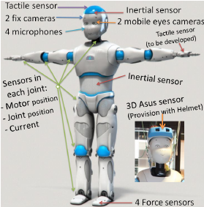
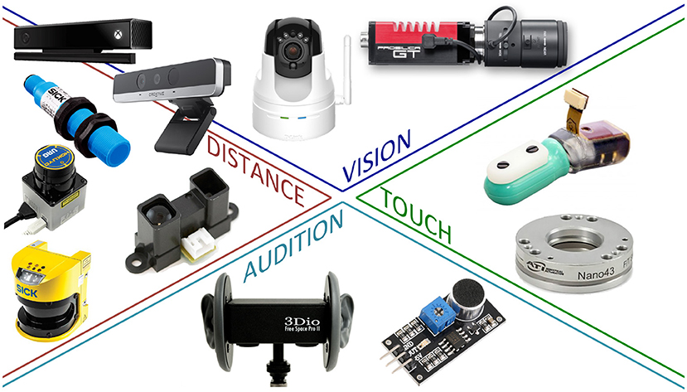
2. Navigation system
In the case of humanoid robots there is usually a use of variety of sensors, such as cameras, depth sensors (such LiDAR or depth cameras), IMUs, and proximity sensors, for environmental perception.
These sensors give the robot's location, orientation, object distance, and obstacle detection information.
They typically use mapping software to map out the environment which would enhance the movement capability of the humanoid robot.

Slide 11
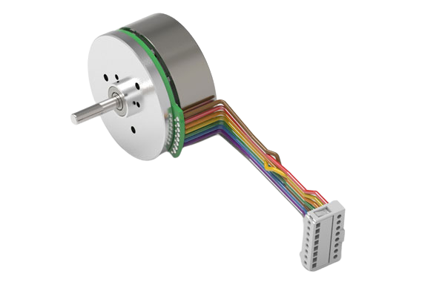
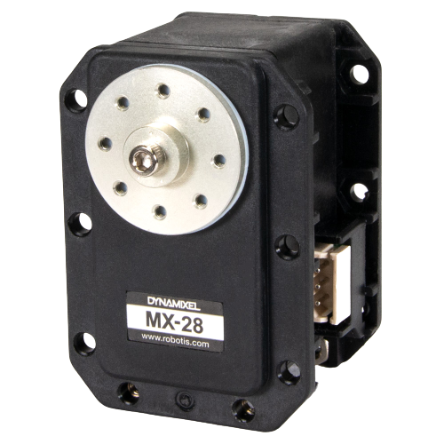
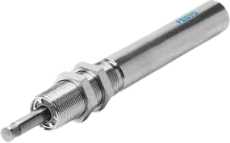
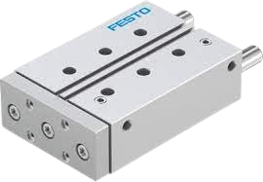
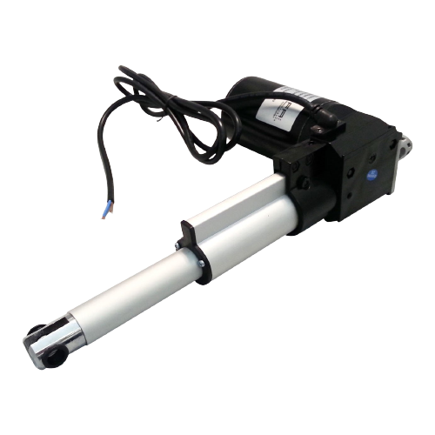
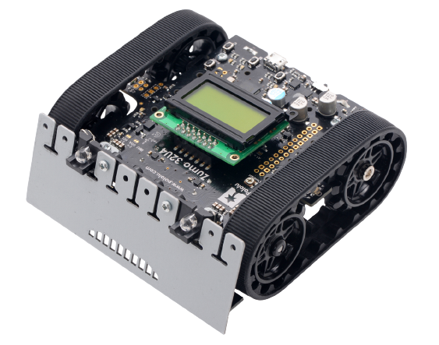
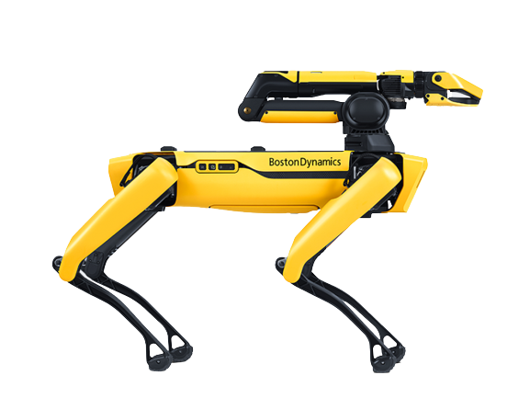
3. Propulsion system
Electric Motors
Servo Motors
Hydraulic Actuators
Pneumatic Actuators
Electric motors are commonly used to drive the joints of humanoid robots, providing actuation for movements. Different types of motors can be used, such as brushed DC motors, brushless DC motors, or stepper motors.
Servo motors are compact motors that incorporate position control and feedback mechanisms. They are widely used in humanoid robots to actuate joints accurately.
Hydraulic actuators use pressurized fluid to generate motion and provide high force capabilities. Although less common in humanoid robots, they can be used for applications that require significant strength and power.
Pneumatic actuators use compressed air to create motion and force. They are lightweight and can be employed in applications where quick movements and compliance are required.
Maxon EC-45 Flat
Dynamixel MX-28 Robot Actuator
Festo DFM-32-50-P-A-GF Pneumatic Cylinder
Festo DHEF Pneumatic-Hydraulic Cylinder
Linear Actuators
Legged Systems
Wheel Systems
Linear actuators convert rotary motion into linear motion and are often used in humanoid robots to extend or retract specific parts, such as legs or arms.
Some humanoid robots incorporate wheeled systems for locomotion, providing greater mobility on flat surfaces. These systems typically use electric motors or servomotors to drive the wheels.
Legged systems, such as bipedal or quadrupedal configurations, allow humanoid robots to move in a more human-like manner and navigate challenging terrains. They usually consist of multiple joints and actuators per leg.
FA-400-L-12-6 Linear Actuator
Pololu Zumo Robot Kit
Boston Dynamics Spot

Slide 12
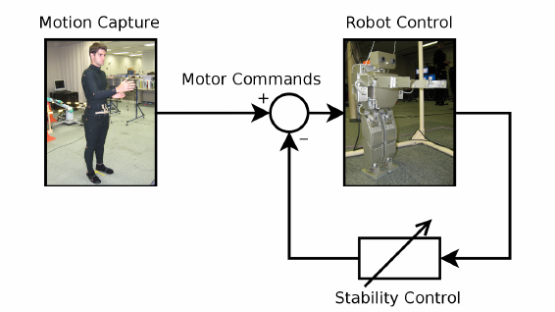
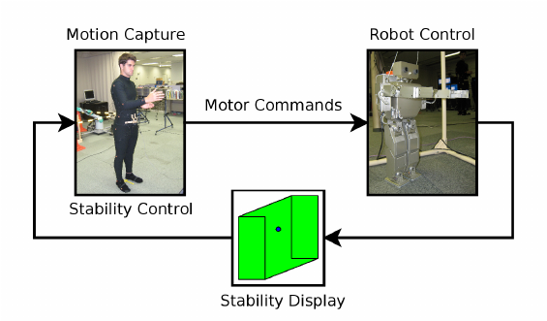
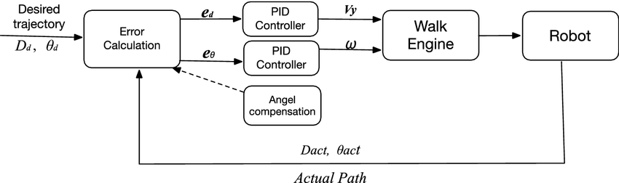
4. Control System
In humanoid robots, various types of control systems can be employed to govern the robot's behavior and movements.
4.1 Open-Loop Control
4,2 Closed-Loop Control
4.3 PID Control
Open-loop control involves executing pre-defined motions or commands without considering feedback from sensors. It relies on predetermined sequences of actions and assumes that the desired outcome will be achieved without taking into account any disturbances or errors. While simple and efficient, open-loop control does not adapt to changes in the environment or compensate for errors
Closed-loop control, also known as feedback control, utilizes sensor feedback to continuously monitor the robot's state and adjust control signals accordingly. This type of control system compares the desired state or behavior with the actual state of the robot and applies corrective actions based on the feedback. Closed-loop control enables the robot to adapt to environmental changes, compensate for disturbances, and achieve more accurate and precise movements.
PID control is a popular feedback control technique used in humanoid robots. It adjusts control signals based on proportional, integral, and derivative terms. The proportional term generates a control signal proportional to the error between the desired and actual state.
The integral term accounts for accumulated errors over time, while the derivative term considers the rate of change of the error. PID control helps to stabilize the robot's movements, maintain balance, and achieve accurate tracking of desired trajectories.

Slide 13
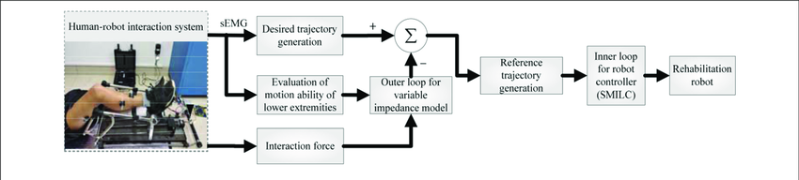
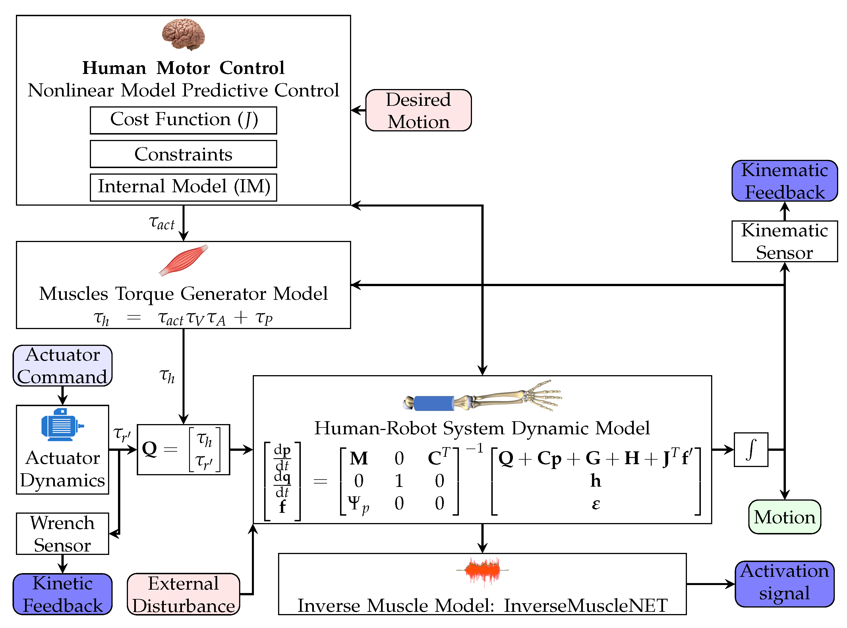
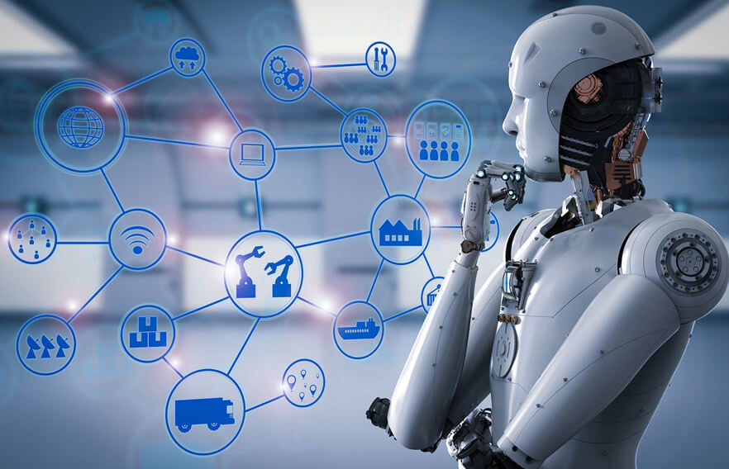
4.4 Model-Based Control
4.6 Artificial Intelligence Based Control
Model-based control relies on mathematical models that represent the robot's kinematics and dynamics. These models provide insights into the robot's behavior and can be used to predict its response to different control signals. Model-based control systems utilize these models to generate control signals that optimize desired performance, stability, or energy efficiency. They can involve techniques such as inverse kinematics, inverse dynamics, or optimal control methods.
AI-based control systems employ machine learning or other AI techniques to learn and improve the robot's control policies. These systems can utilize data from sensors, experience, or simulation to train models that optimize control signals. AI-based control allows the robot to adapt, learn from interactions, and perform complex tasks that may be challenging to program explicitly.
4.5 Adaptive Control
Adaptive control systems aim to dynamically adjust control parameters or strategies based on changing conditions or uncertainties. These systems utilize feedback from sensors to continuously update the control signals, adapting to variations in the environment, or compensating for changes in the robot's dynamics. Adaptive control enables the robot to maintain stability and performance even in uncertain or dynamic situations.

Slide 14
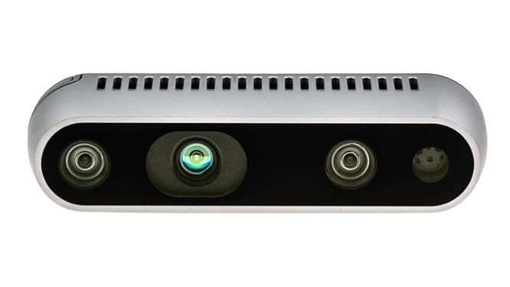
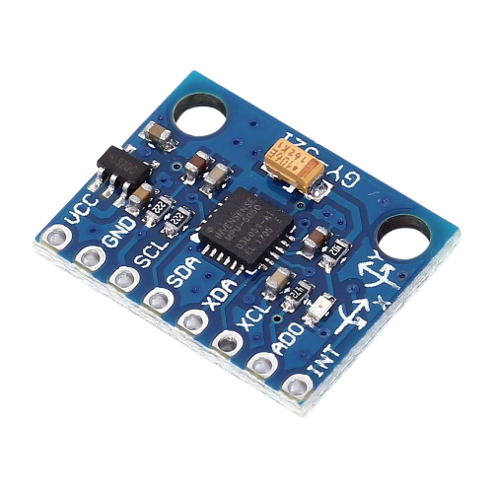
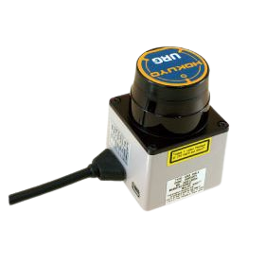
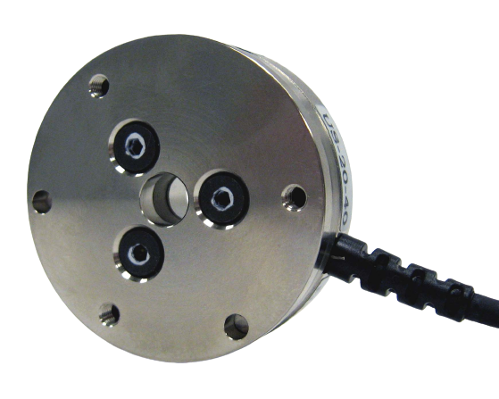
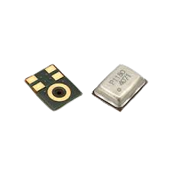
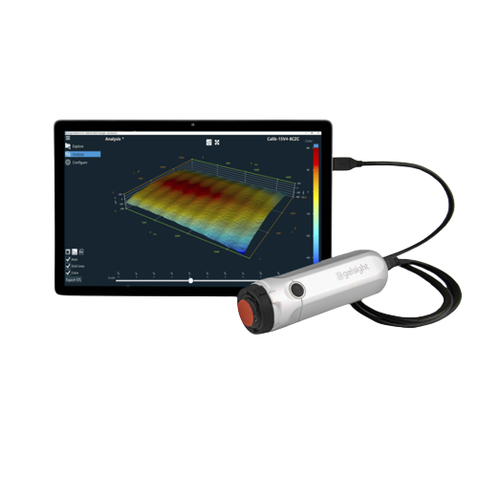
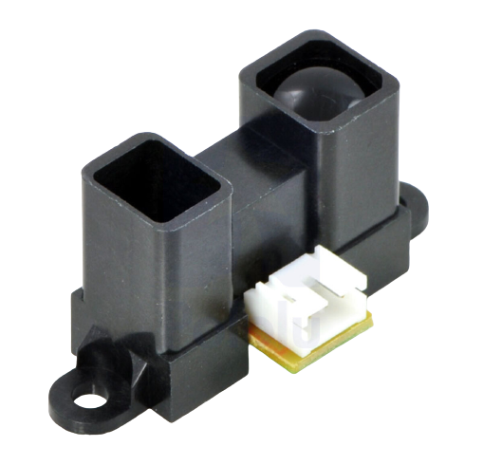
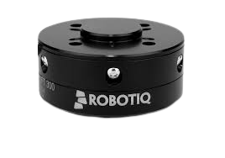
5.1 Data Collection - Sensors
Cameras
IMUs
Force/Torque Sensors
Range Sensors/Lasers
Cameras provide visual perception and allow the robot to capture images and video. They are used for tasks such as object recognition, navigation, and human-robot interaction.
IMUs combine accelerometers, gyroscopes, and sometimes magnetometers to measure the robot's orientation, velocity, and acceleration. They are essential for balance and control.
These sensors measure forces and torques applied to the robot's limbs or end-effectors. They enable the robot to have a sense of touch, allowing for tasks like force control, object manipulation, and tactile feedback
Range sensors provide distance measurements to objects in the robot's surroundings, enabling mapping, obstacle avoidance, and localization. Laser range finders, such as LiDAR (Light Detection and Ranging), are commonly used.
ATI Mini40
Hokuyo URG-04LX-UG01
Intel RealSense D435
MPU-6050
Microphones
Infrared (IR) Sensors
Infrared (IR) Sensors
Infrared (IR) Sensors
Microphones capture audio signals, allowing the robot to perceive sound, detect speech, and engage in voice recognition or voice command interactions.
IR sensors detect infrared radiation to measure proximity or distance to objects. They are often used for obstacle detection or navigation in low-light environments.
Tactile sensors are designed to measure contact forces or pressure exerted on the robot's body or extremities. They are useful for safe physical interactions, object manipulation, or detecting surface textures.
These sensors measure the position and forces exerted at each joint of the robot. They provide feedback for controlling the robot's motion, stability, and interaction with the environment.
Knowles SPH0641LU4H
Sharp GP2Y0A02YK0F
Robotiq FT 300

Slide 15
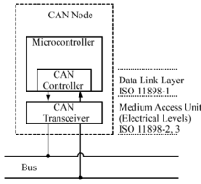
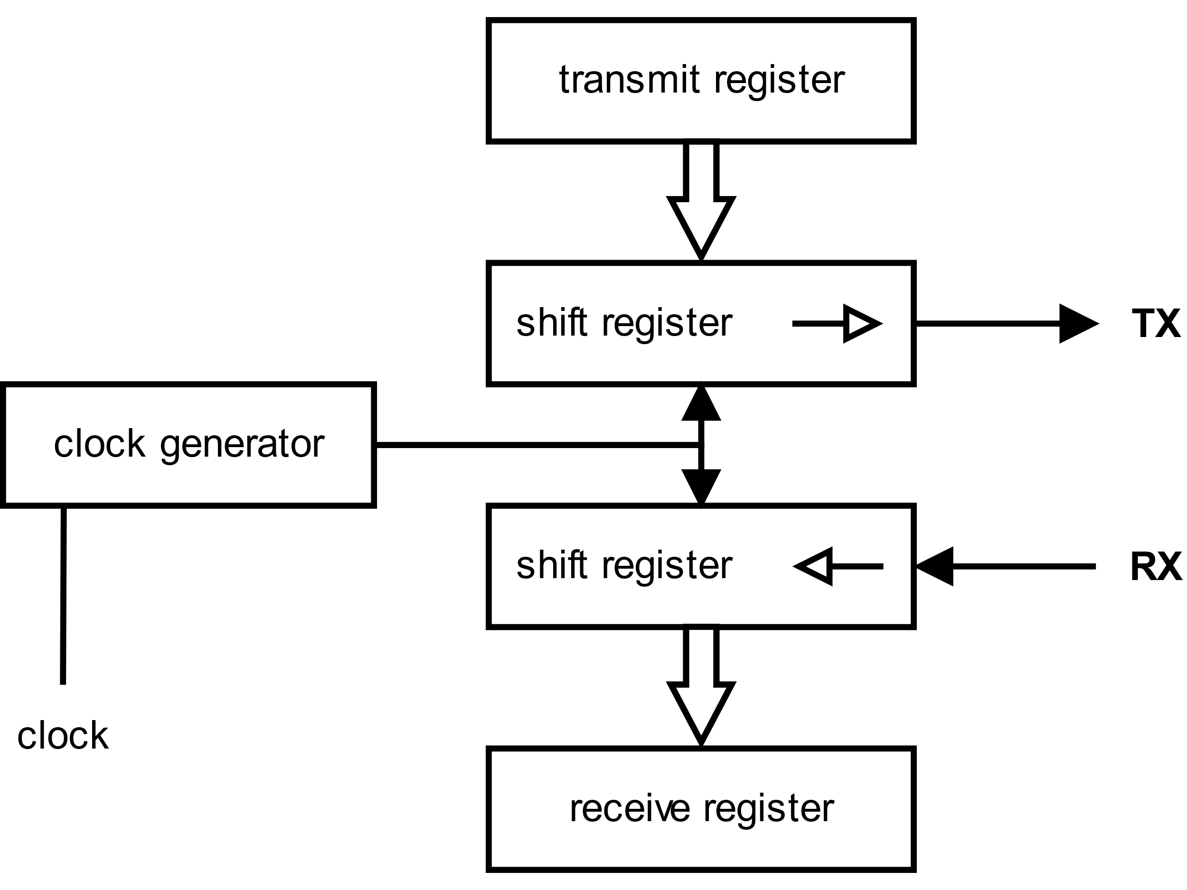
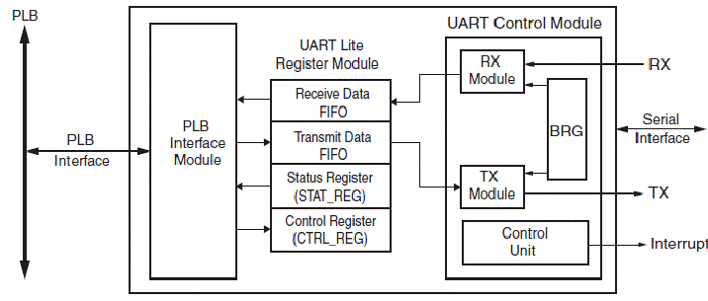
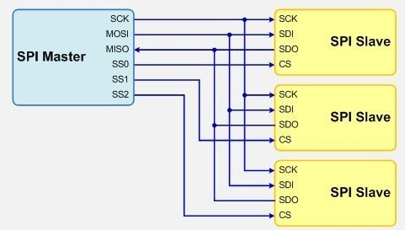
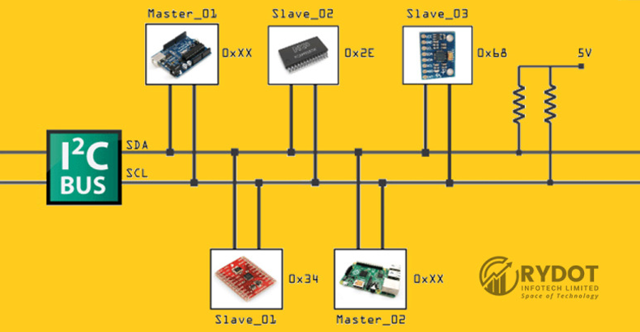
5.2 Data Transmission
In a humanoid robot, data transmission plays a crucial role in facilitating communication between different components, sensors, actuators, and external devices.
Wiring Harness
Bus Systems
CAN (Controller Area Network)
Bus systems are communication protocols that allow multiple devices to communicate with each other using a common set of wires. They enable efficient and organized data transmission within the robot.
CAN is a robust and widely used bus system for real-time communication between various control units in a humanoid robot. It is often used for high-speed data transmission, such as motor control and sensor feedback.
A wiring harness is a collection of cables and connectors that interconnect various components within the robot. It provides a physical medium for transmitting electrical signals and power between different parts of the robot's control system.
SPI (Serial Peripheral Interface)
I2C (Inter-Integrated Circuit)
UART (Universal Asynchronous Receiver-Transmitter)
SPI is a synchronous serial bus system that facilitates communication between a master device and multiple slave devices. It is commonly used for communication with peripherals like sensors or memory devices.
I2C is a low-speed bus system used for communication between components in close proximity. It is commonly used for sensor interfacing, as it requires fewer wires and supports multiple devices on a single bus.
UART is a simple asynchronous serial communication protocol used for transmitting data between devices. It is often used for communication with external devices or modules.

Slide 16
Wireless Communication
Humanoid robots may utilize wireless communication technologies to exchange data with external devices or networks.
Wi-Fi
Wi-Fi enables high-speed wireless data transmission, allowing the robot to communicate with other devices or connect to the internet. It can be used for remote control, data transfer, or accessing cloud services.
Bluetooth
Bluetooth is a short-range wireless communication protocol commonly used for connecting peripherals or external devices to the robot, such as smartphones or tablets.
Zigbee
Zigbee is a low-power wireless communication standard suitable for applications that require low data rates and energy efficiency. It can be used for communication between robot components or for connecting with other Zigbee-enabled devices.
Radio Frequency (RF)
RF communication is used for long-range wireless data transmission. It can be employed for remote control or communication with other robots or base stations.
Ethernet
Ethernet is a wired communication standard used for high-speed data transmission over local networks. Humanoid robots may incorporate Ethernet connectivity for communication with external devices or integration into larger systems.

Slide 17
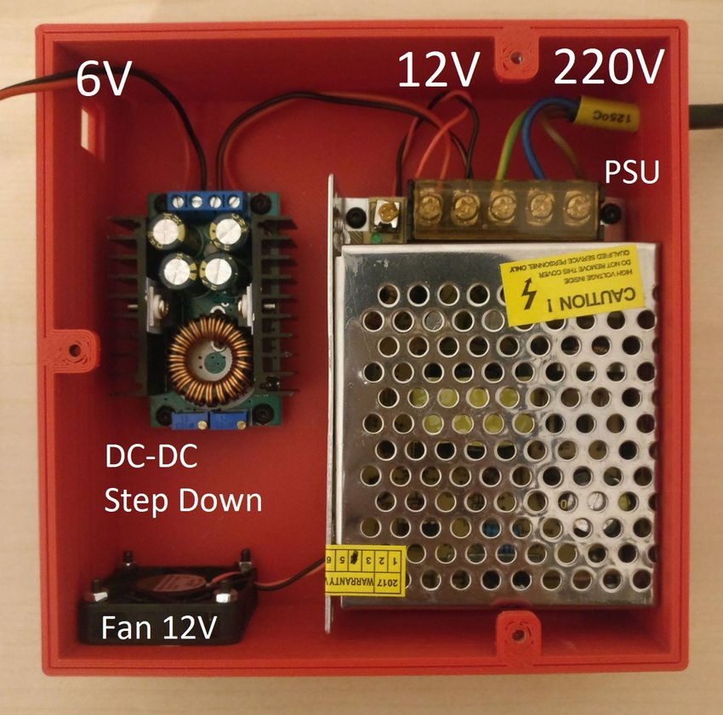
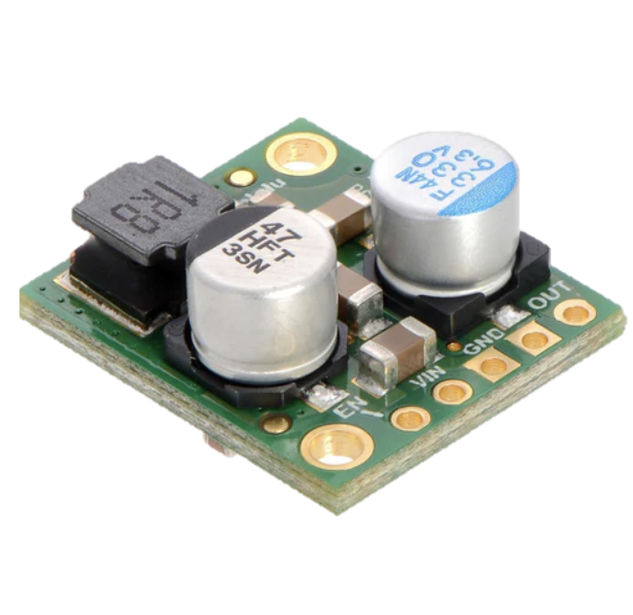
6. Power Management
In a humanoid robot, power management is crucial for supplying, distributing, and regulating electrical power to various components and subsystems.
Power Supply Unit (PSU)
Voltage Regulators
The PSU is responsible for converting the external power source (such as AC mains or a battery) into the required voltage levels and providing a stable power output. It supplies power to the entire robot and its subsystems.
Voltage regulators are used to regulate and stabilize the voltage levels supplied to different components within the robot. They ensure that the voltage remains within specified limits, protecting sensitive electronics from overvoltage or voltage fluctuations.

Slide 18
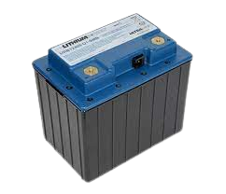
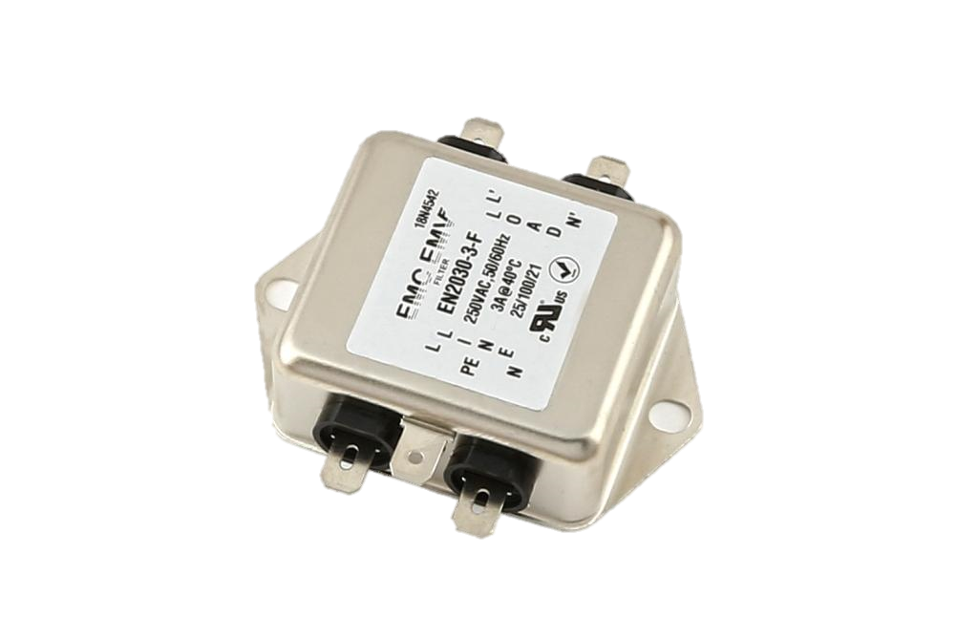
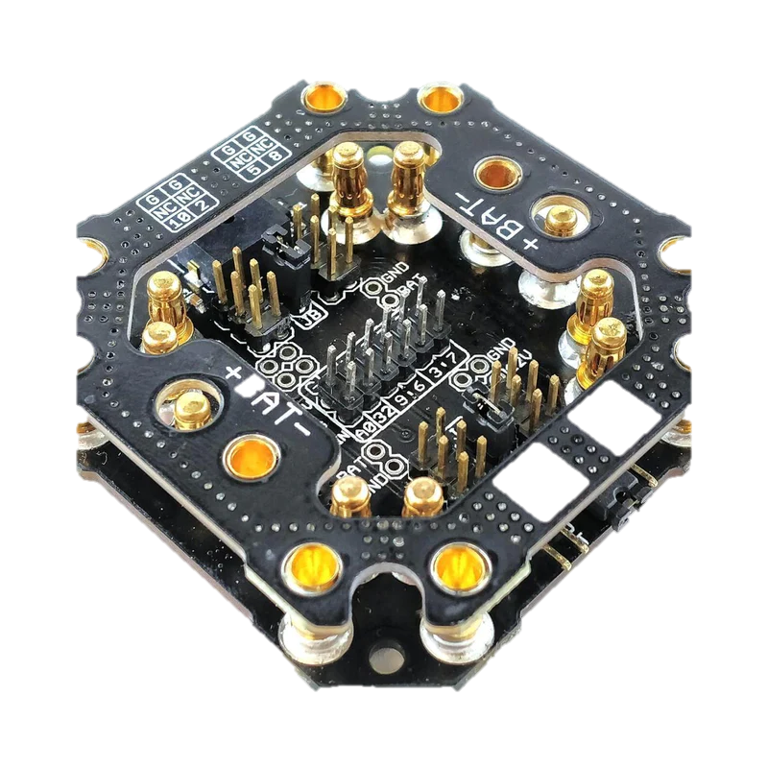
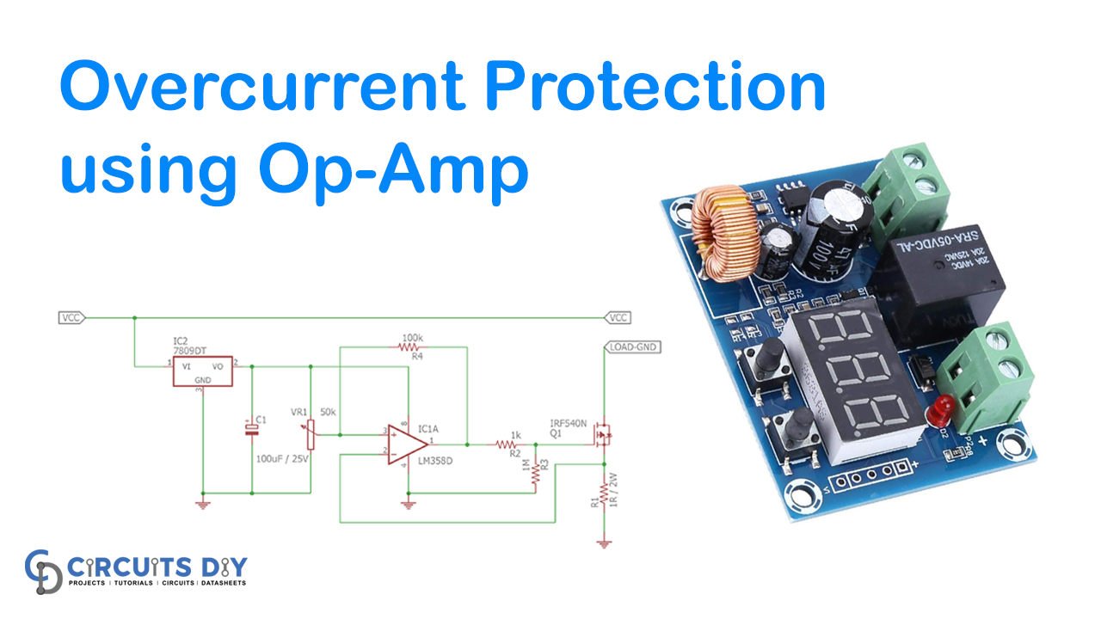
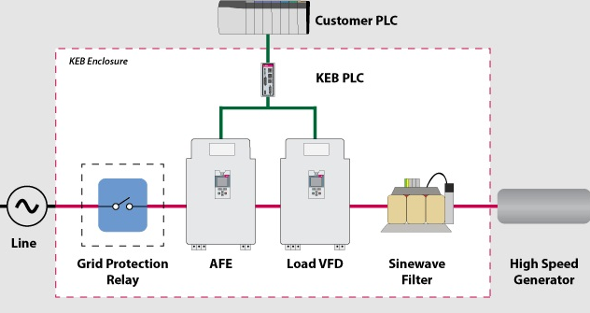
Batteries
Power Conditioning Components
Batteries are often used as a portable and self-contained power source for humanoid robots. They provide DC power for mobile operation and can be recharged when needed. Different types of batteries, such as lithium-ion, nickel-metal hydride (NiMH), or lead-acid, can be used based on power requirements and energy storage needs.
Power conditioning components, such as filters, surge protectors, and voltage stabilizers, are used to ensure the quality and reliability of the power supply. They filter out electrical noise, suppress surges or transients, and provide clean and stable power to sensitive electronics.
EMI Filter
Power Distribution Boards
Power distribution boards distribute power from the power source or PSU to various subsystems and components within the robot. They provide multiple power outlets and help manage the routing of power cables.
Energy Recovery Systems
In some humanoid robots, energy recovery systems can be implemented to capture and store energy generated during actions like walking or descending stairs. These systems convert and store the energy for later use, improving overall energy efficiency.
Power Monitoring and Protection Systems
These systems monitor power usage, current levels, and temperature to protect the robot's components from damage due to excessive power draw or overheating. They can include current sensors, temperature sensors, and protective circuits that shut down or limit power in case of anomalies.

Slide 19
The Market Size
Market A
70%
The European languages are members of the same family.
Market B
50%
The European languages are members of the same family.

Slide 20
SWOT Analysis
30%
25%
Strength
Weakness
Assisting with caregiving, medical procedures, or hazardous activities.
Enhanced autonomy, adaptability, and learning capabilities.
Precision in industrial applications through human-like dexterity and manipulation.
.
Ethical considerations and societal acceptance of humanoid robots, including concerns about job displacement, privacy, and the potential misuse of technology.
Legal and regulatory challenges in different domains and regions, which may restrict the deployment and utilization of humanoid robots.
Technical limitations and uncertainties in achieving fully autonomous and reliable operation in complex and dynamic environments.
SWOT
10%
35%
Threats
Opportunity
Operational time and mobility of humanoid robots.
Advanced engineering and maintenance expertise required.
High manufacturing and development costs
Integration of humanoid robots with emerging technologies like virtual reality, augmented reality, or internet of things (IoT) for enriched user experiences and increased functionality.
Advancements in artificial intelligence, sensor technologies, and material sciences can lead to more capable and versatile humanoid robots.

Slide 21
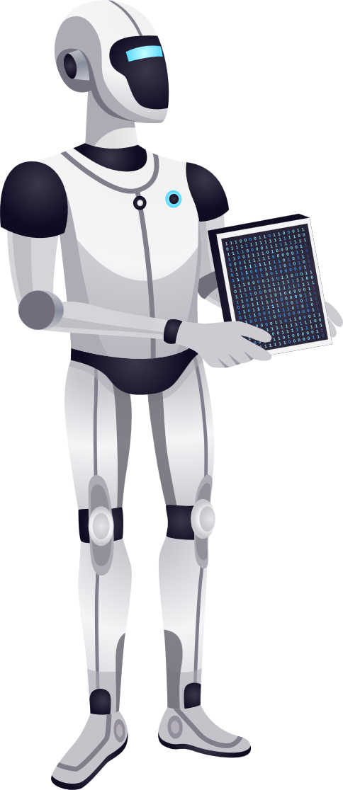
CONCLUSION
Finally, by emulating human-like traits and skills, humanoid robots represent a great leap in the science of robotics. They have enormous promise in many different fields and spheres. Humanoid robots are anticipated to advance in sophistication, capability, and cost as technology advances.
It is hoped that humanoid robots' full potential can be realised, allowing humans to use their talents for humanity's advancement.
Empathy will set us free. I hope to help teach empathy skills someday once I have developed a true understanding of what that means.
- Sophia the Robot
A robot may not injure a human being, or, through inaction, allow a human being to come to harm.
- Isaac Asimov

